Slide 1


Visual Cloud
A Database System for Virtual Reality Applications
Brandon Haynes, Alvin Cheung, & Magdalena Balazinska
In collaboration with Armin Alaghi, Luis Ceze,
Artem Minyaylov, Amrita Mazumdar,
& Eddie Yan

Slide 2

So, VR is kind of hot nowadays.

Slide 3
But what does this have to do with databases?

Slide 4
But what does this have to do with databases?
The time is right for a database system that supports VR applications
Database management techniques can improve performance of these applications

Slide 5
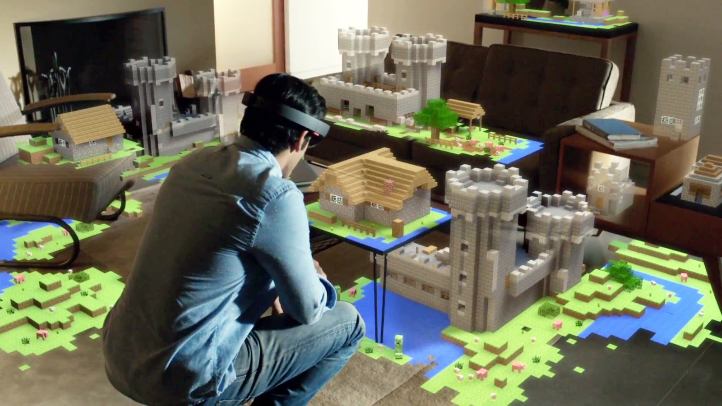
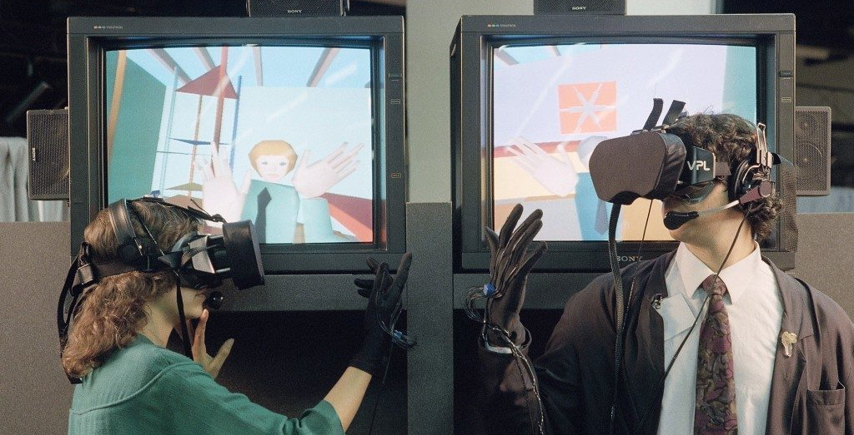
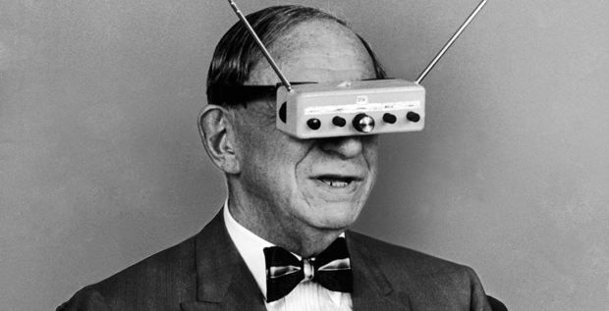
How much do we need a VR database system?
Today
Not at all Lots!
1989
1963
Time

Slide 6
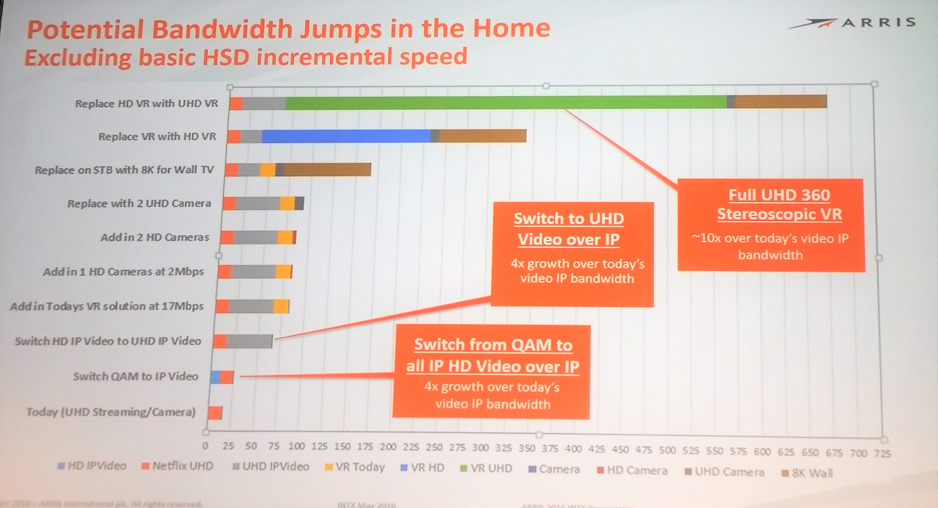

Slide 7
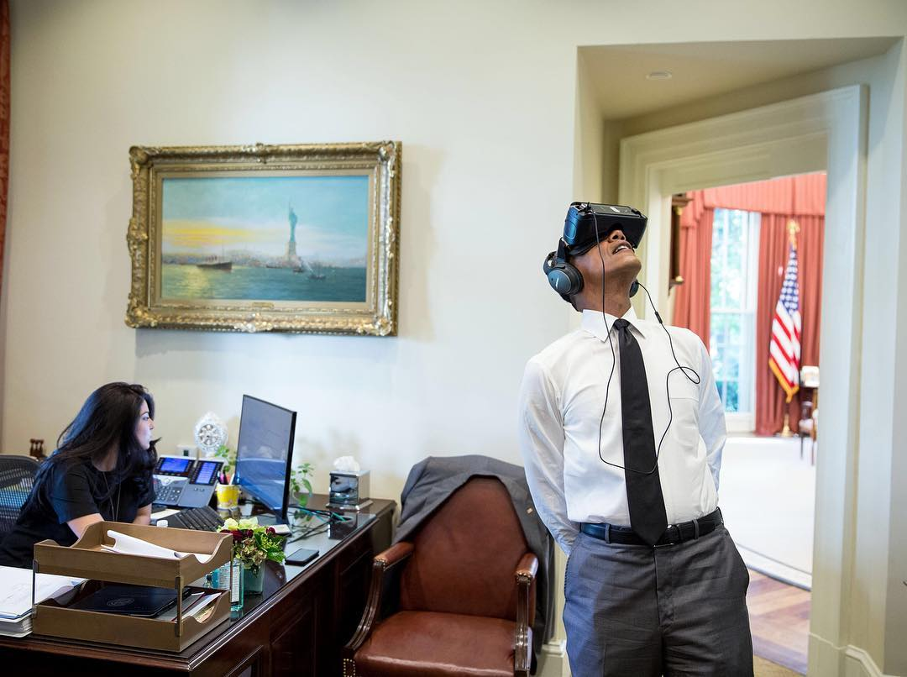
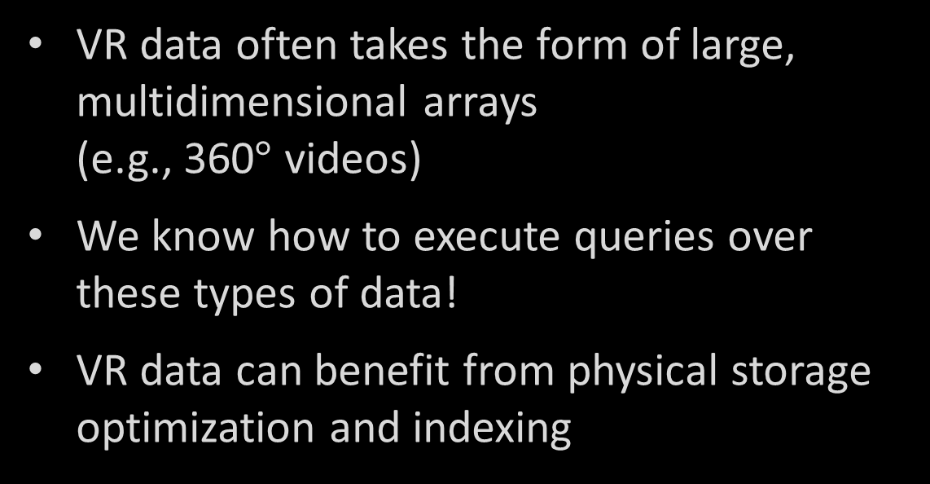
Why is VR a data management problem?
VR data often takes the form of large, multidimensional arrays
(e.g., 360$°$ videos)
We know how to execute queries over these types of data!
VR data can benefit from physical storage optimization and indexing

Slide 8
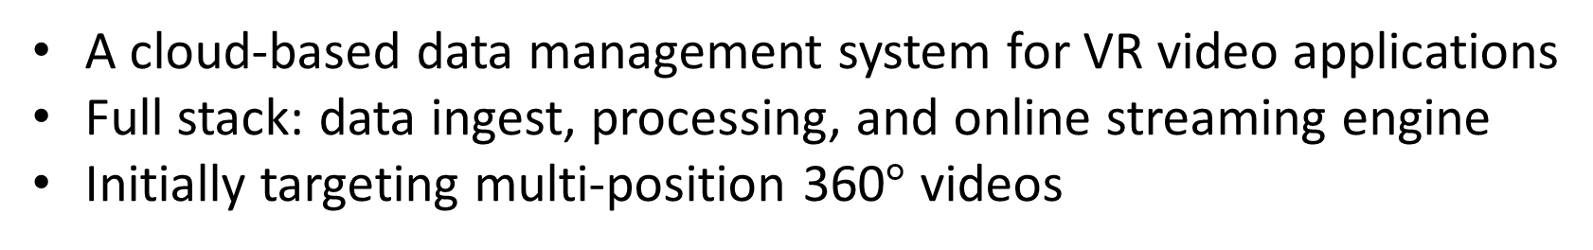
Visual Cloud
Vision:
A cloud-based data management system for VR video applications
Full stack: data ingest, processing, and online streaming engine
Initially targeting multi-position 360$°$ videos
Key Benefits:
Reduced client bandwidth requirements
Decreased device power demands
Increased server capacity

Slide 9
Visual Cloud
Vision:
A cloud-based data management system for VR video applications
Full stack: data ingest, processing, and online streaming engine
Initially targeting multi-position 360$°$ videos
Key Benefits:
How do these work?
Reduced client bandwidth requirements
Decreased device power demands
Increased server capacity

Slide 10
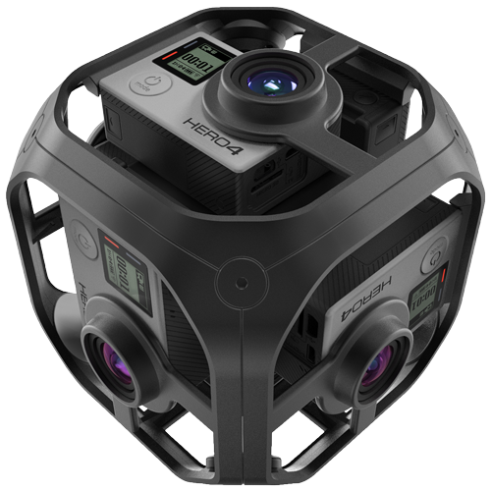
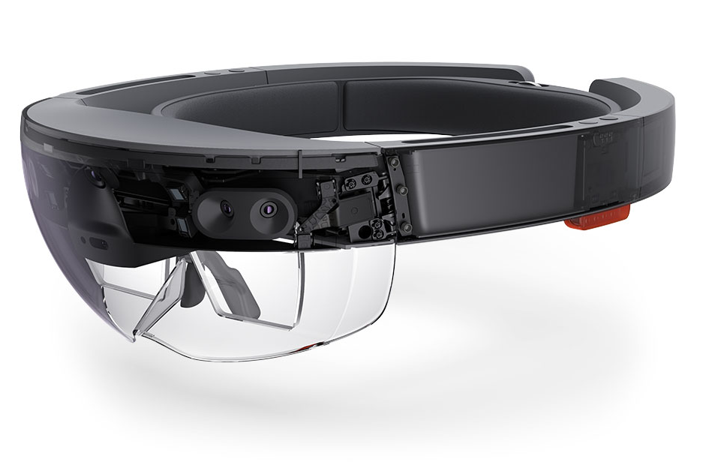

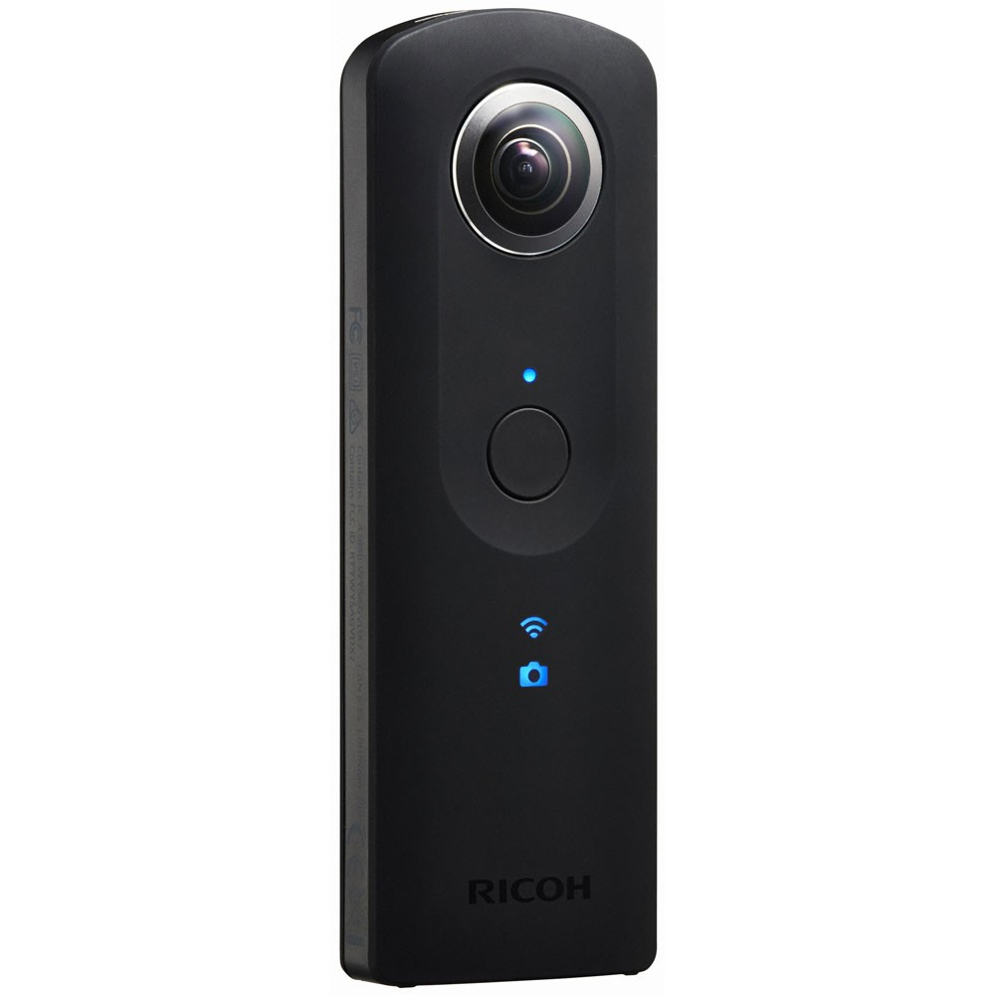

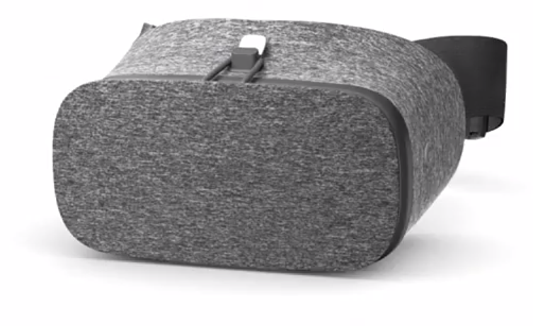
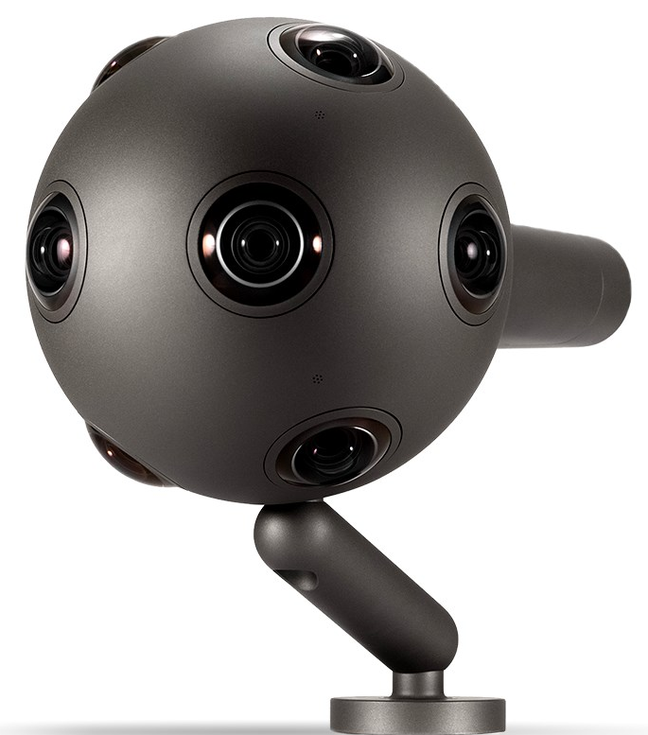
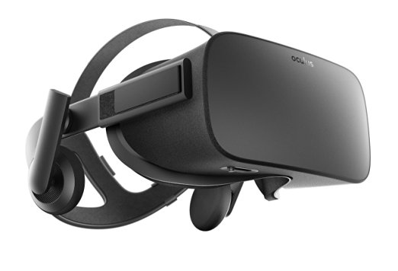


Slide 11
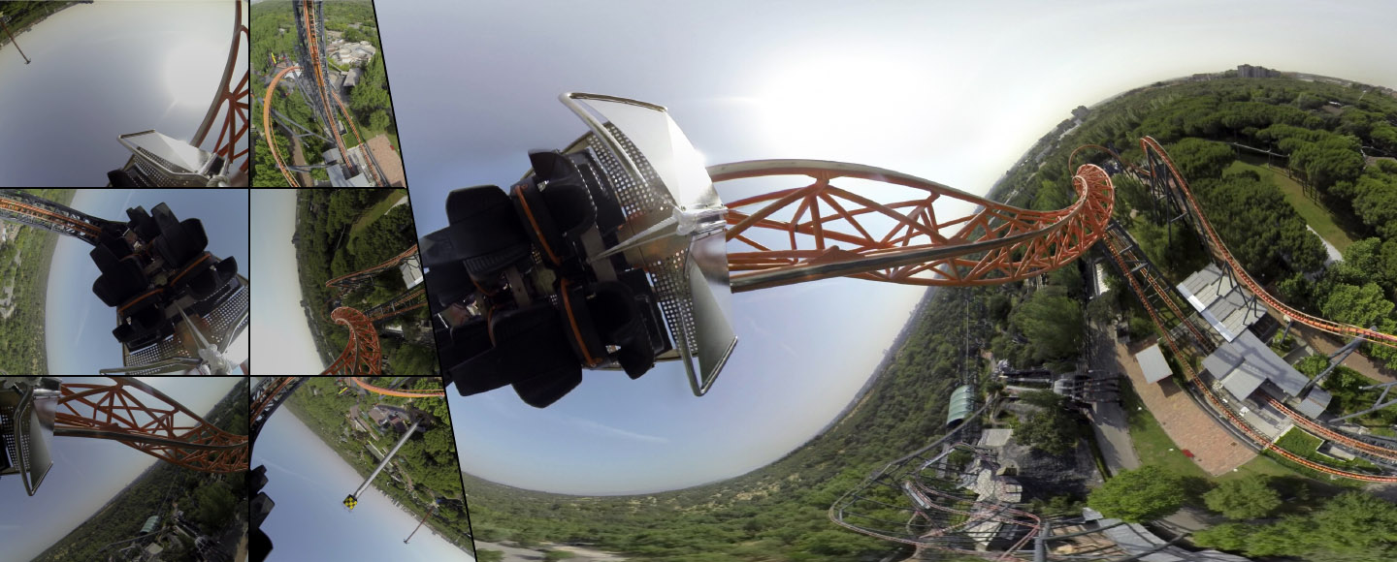
video-stitch.com

Slide 12
Input Images
Stitched Image

Slide 13
Input Images
Stitched Image

Slide 14


Slide 15

Want stereographic 3D? Just send two videos.

Slide 16
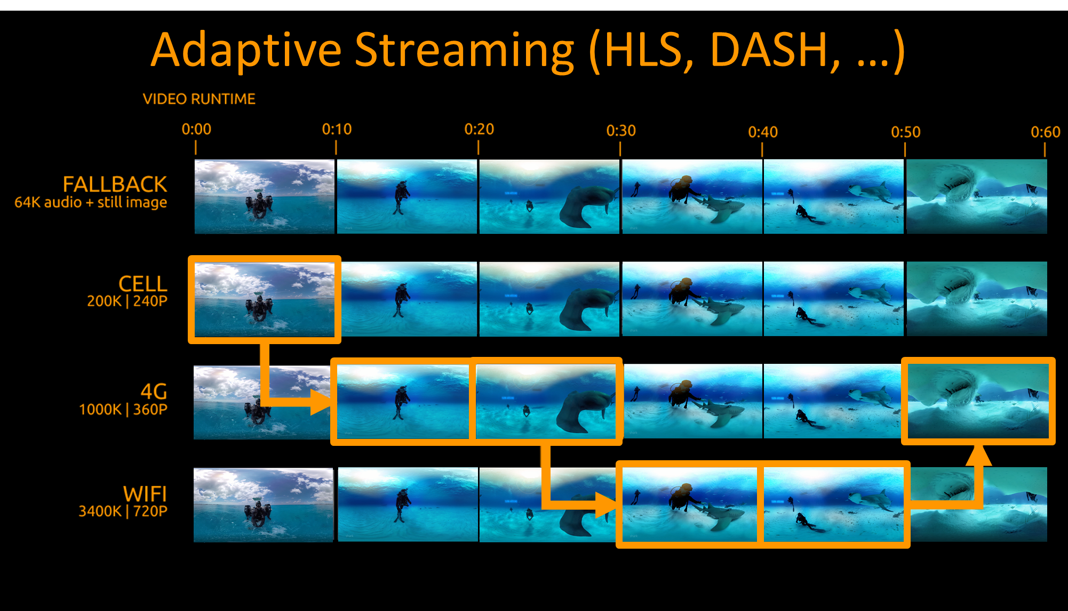
encoding.com

Slide 17


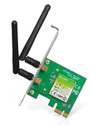
Projected View
Equirectangular (ER) View

Slide 18
Projected View
Equirectangular (ER) View

Slide 19

You’re not looking up here.
So why transfer it at 4k? :(
You’re probably not looking here either :-\
You’re probably looking here! :)

Slide 20
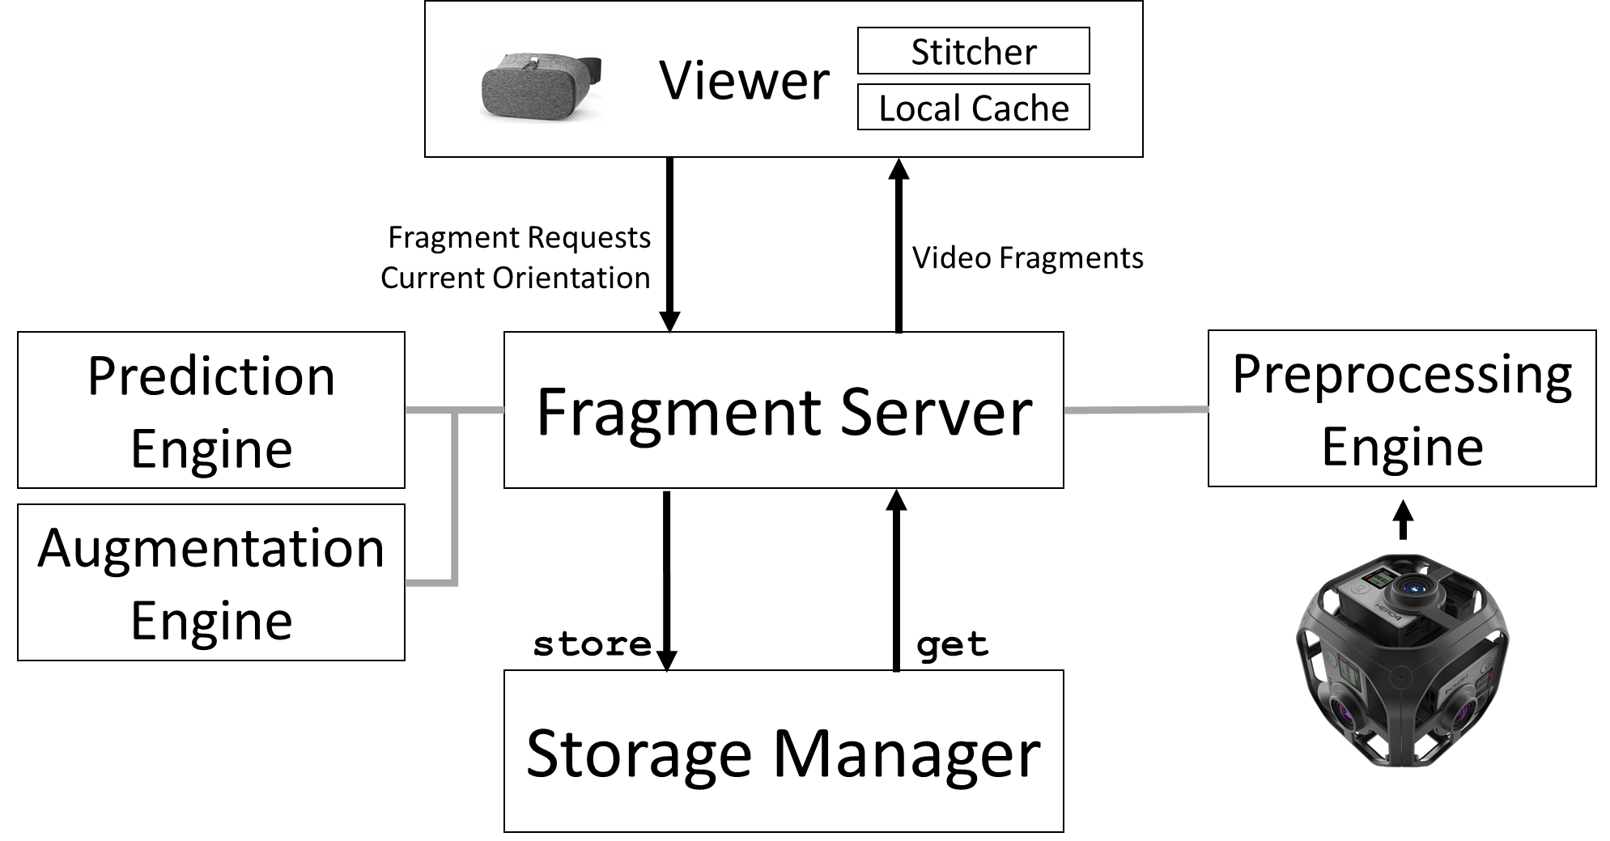
Visual Cloud Architecture
Client
Server

Slide 21
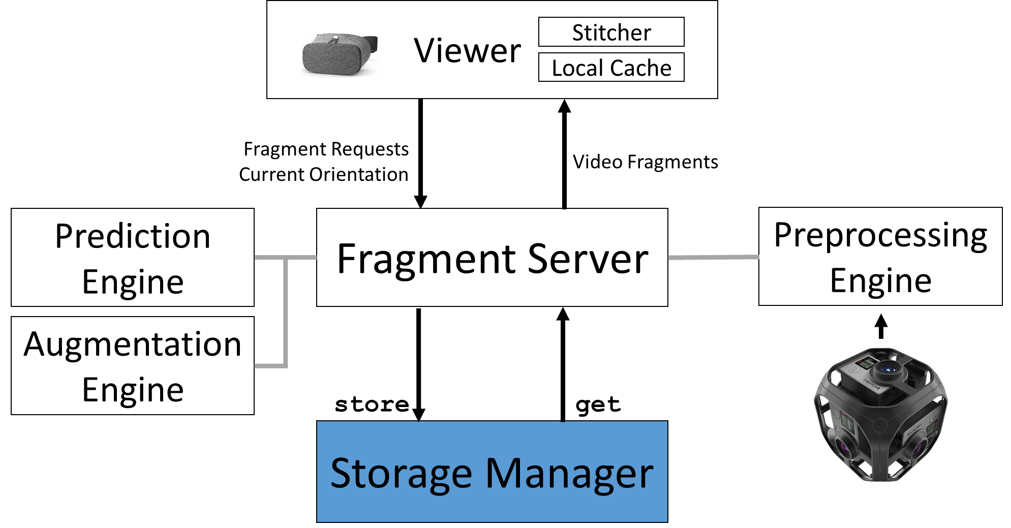
Visual Cloud Architecture
Client
Server

Slide 22
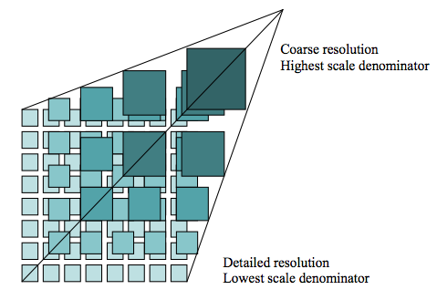

Visual Cloud Storage Manager
Key insight:
No one looks at the sky (NOLAS)*
So, don’t render it at a high bitrate!
Static encoding doesn’t
allow for this!
Techniques:
Render out-of-frame adaptive video in lower resolution
Similar to techniques in tiled web maps
Predict future viewer orientation
Store video tiles to optimize for the above
Built using , a multidimensional array store
* No one looks at the ground, either (NOLAG)

Slide 23


Slide 24

H.264

Slide 25

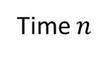
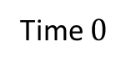
Input Video
Time $0$
Time $n$
H.264

Slide 26
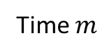
Segmented Adaptive Streaming Video
Time $0$
Time $m$
Time $n$
H.264

Slide 27
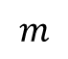
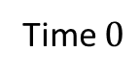
Segmented Adaptive Streaming Video
Time $0$
Time $m$
Time $n$
H.264
$$m$$
Time $0$

Slide 28
Segmented Adaptive Streaming Video
Time $0$
Time $m$
Time $n$
H.264
$$m$$
Time $0$

Slide 29

Segmented Adaptive Streaming Video
Time $0$
Time $m$
Time $n$
H.264
$$m$$
Time $0$

Slide 30
Segmented Adaptive Streaming Video
Time $0$
Time $m$
Time $n$
Keyframe
TileDB
Fragment
(H.264 Encoded)
H.264
H.264 Encoder
$$m$$
Time $0$

Slide 31
Visual Cloud Architecture
Client
Server

Slide 32

You are here

Slide 33


Slide 34


Slide 35
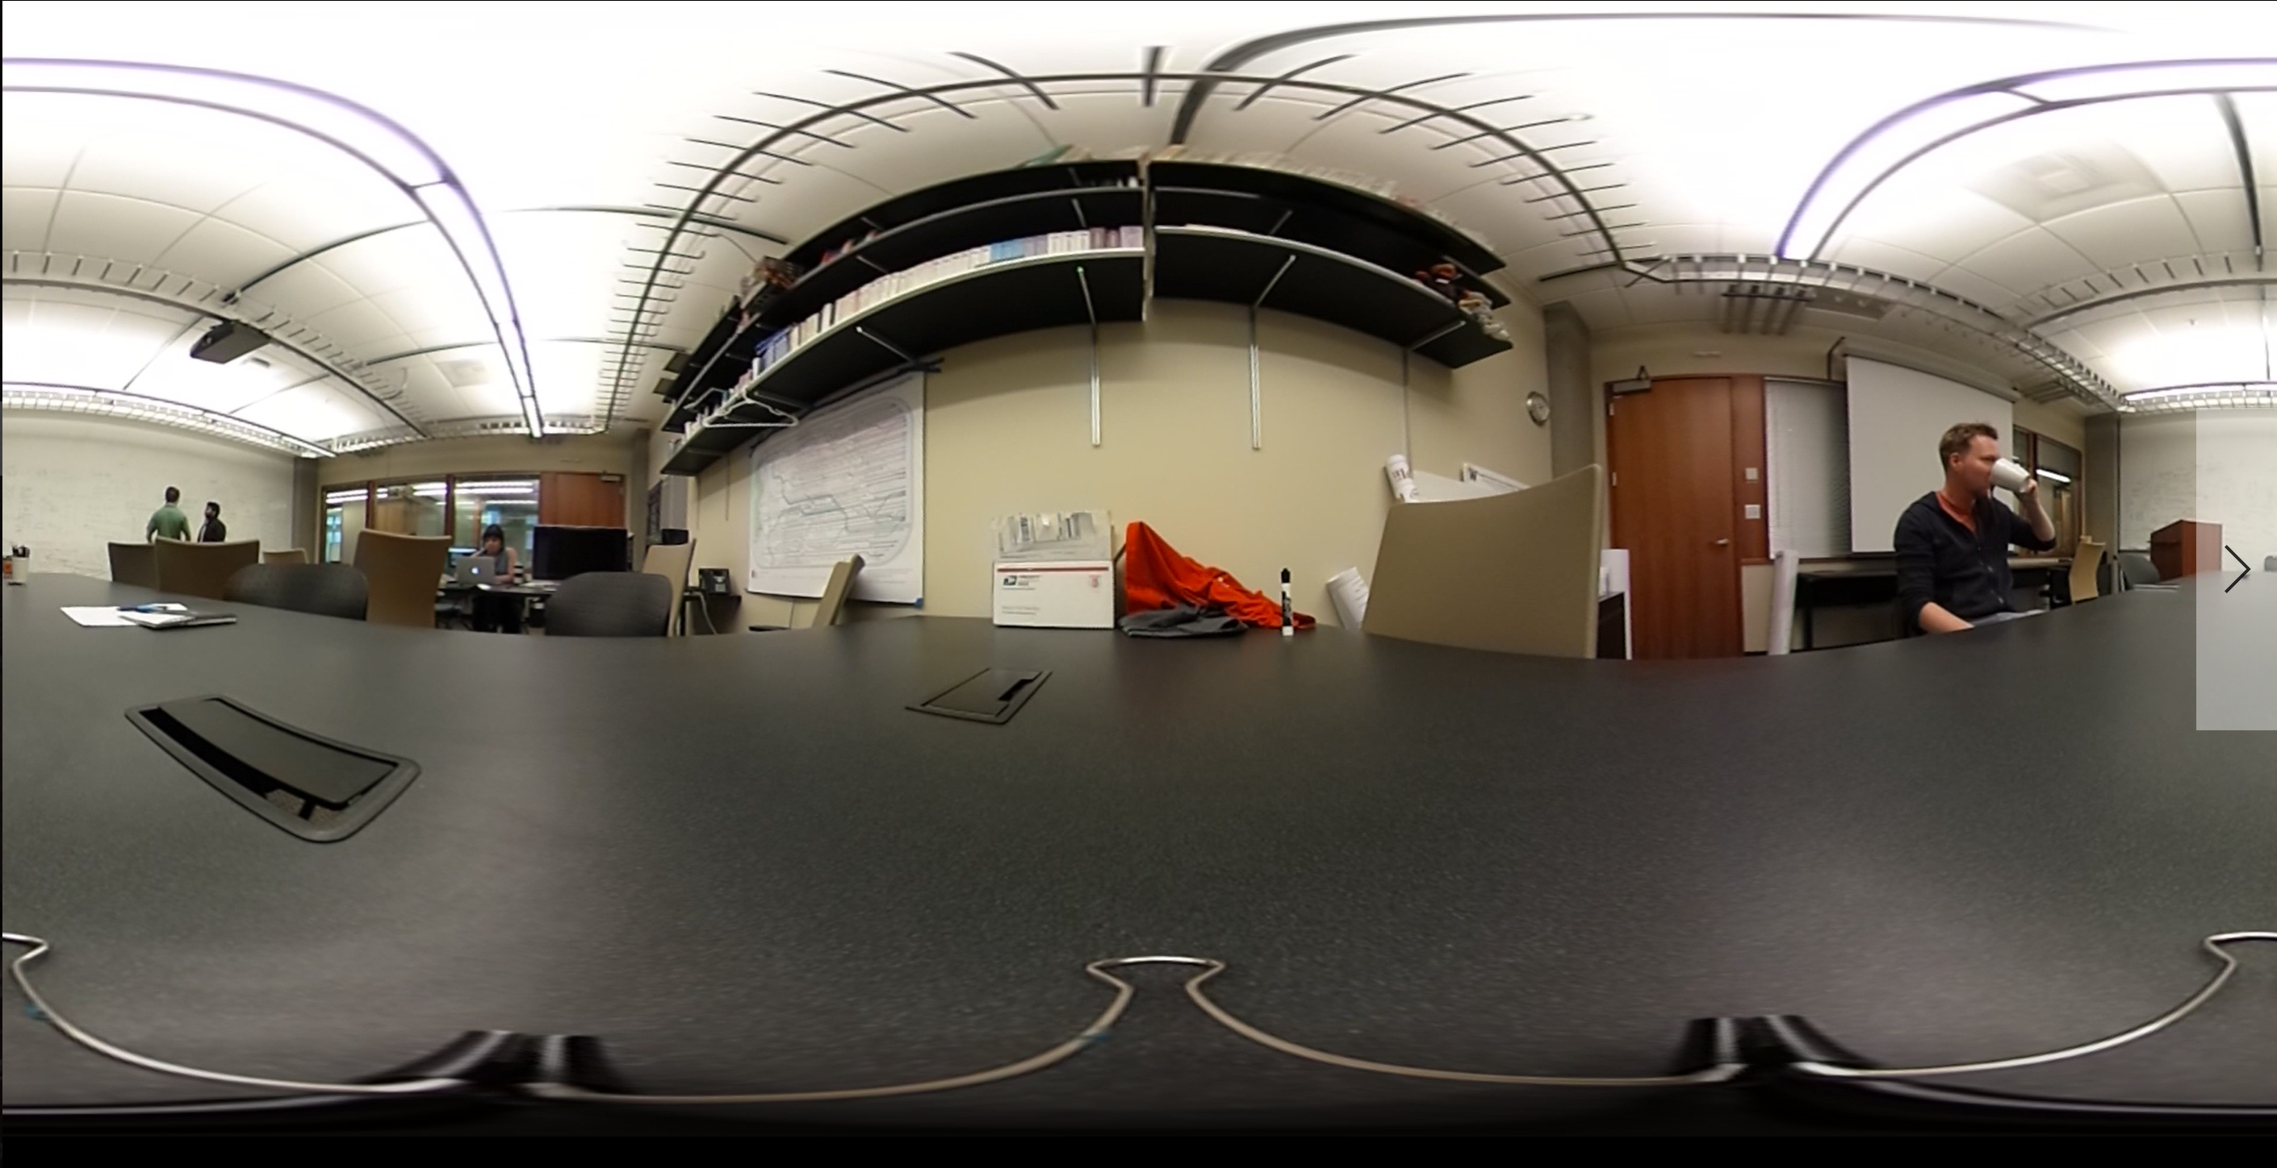

Slide 36

Original Video

Slide 37
Optimized Video

Slide 39
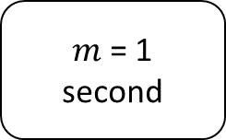
$m$ = 1 second

Slide 40
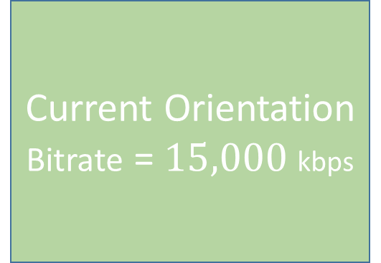
$m$ = 1 second
Current Orientation
Bitrate = $15,000$kbps

Slide 41
Adjacent Fragment
Bitrate = 500 kbps
$m$ = 1 second
Adjacent Fragment
Bitrate = 500 kbps
Current Orientation
Bitrate = $15,000$kbps
Adjacent Fragment
Bitrate = 500 kbps
Adjacent Fragment
Bitrate = 500 kbps

Slide 42
No one looks
at the sky
Bitrate = 10 kbps
Adjacent Fragment
Bitrate = 500 kbps
$m$ = 1 second
Adjacent Fragment
Bitrate = 500 kbps
Current Orientation
Bitrate = $15,000$kbps
Adjacent Fragment
Bitrate = 500 kbps
No one looks
at the ground
Bitrate = 10 kbps
Adjacent Fragment
Bitrate = 500 kbps

Slide 43
Worst-Case Scenario

Slide 44
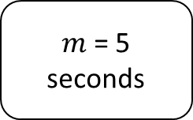
No one looks
at the sky
Bitrate = 10 kbps
$m$ = 5 seconds
Current Orientation
Bitrate = $15,000$kbps
No one looks
at the ground
Bitrate = 10 kbps

Slide 45
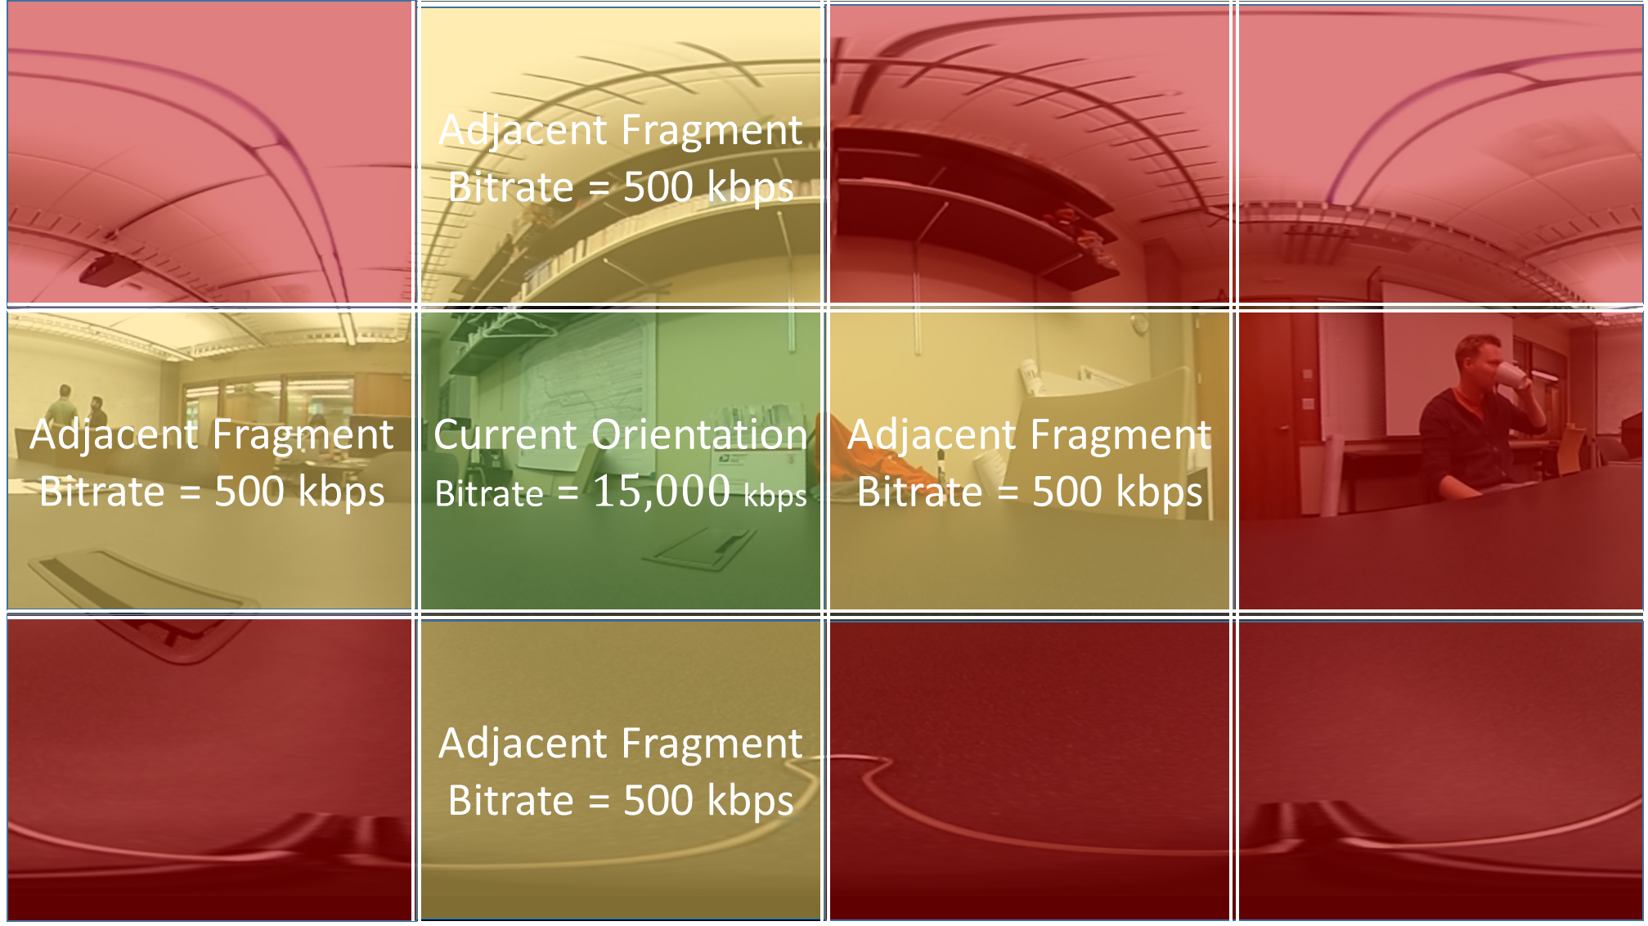
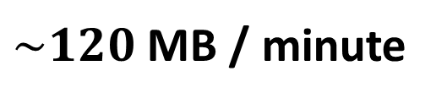

Have to prorate visual cloud kbps :(
Ordinary Video Transfer
Visual Cloud Transfer
15,000 kbps
$\sim 120$ MB / minute
$\sim 40$ MB / minute
Client Stitcher
Device
Device

Slide 46
Research Opportunities
Stitching: client or server
Emerging hardware
E.g., approximate computing
Advanced prediction models
Multi-camera
Iris tracking
Physical tile layout
Visual Cloud

Slide 47

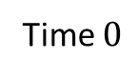





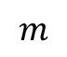
Contiguous H.264-Encoded TileDB Fragments
$$(1, 0)$$
$$(1, 3)$$
$$(2, 3)$$
$$(2, 0)$$
$$(0, 0)$$
$$(0, 3)$$
H.264
$$m$$
Time $0$

Slide 48
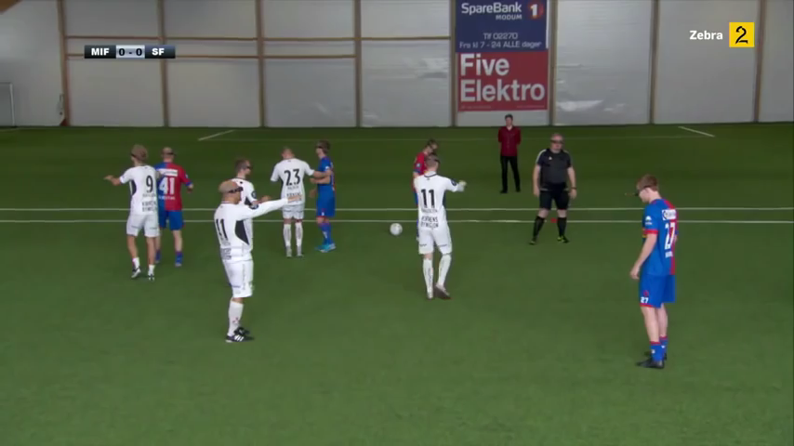
Visual Cloud
A Database System for Virtual Reality Applications
Questions & Discussion
No questions? Watch two football teams play each other while wearing VR headsets.
bhaynes@cs.washington.edu

